Slide 1
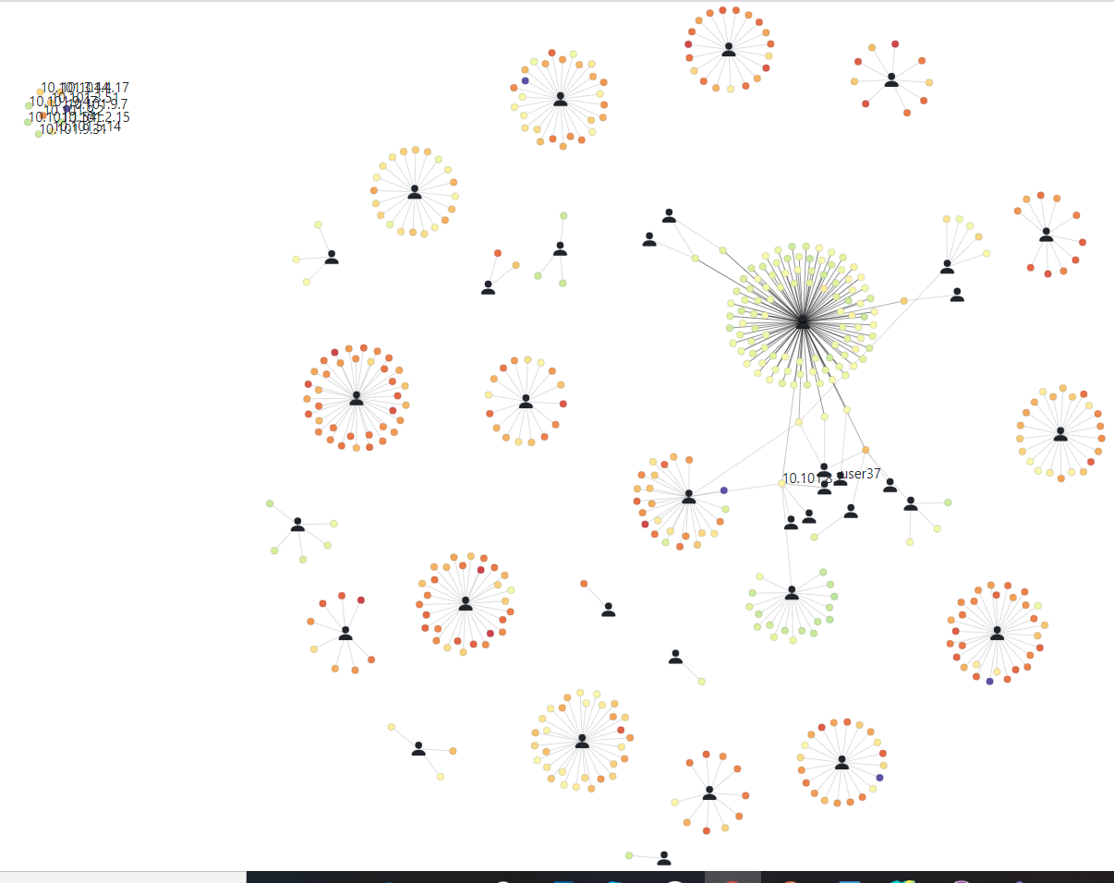
Dynet3D
Weekly report

Slide 2
Job Net
Add Job to network

Slide 3
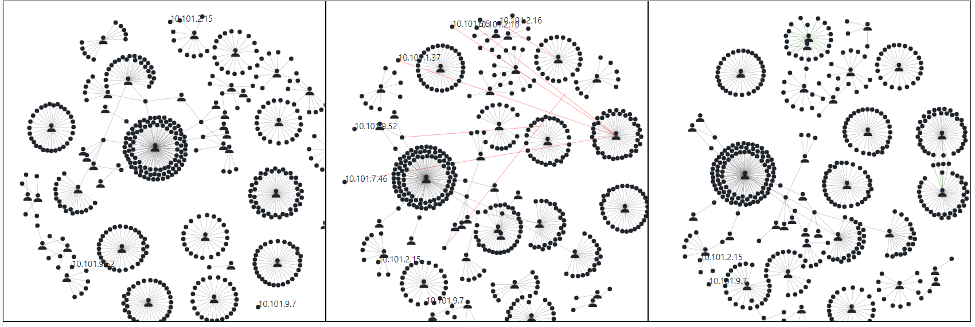
Job Net – Time slices
Independent forces

Slide 4
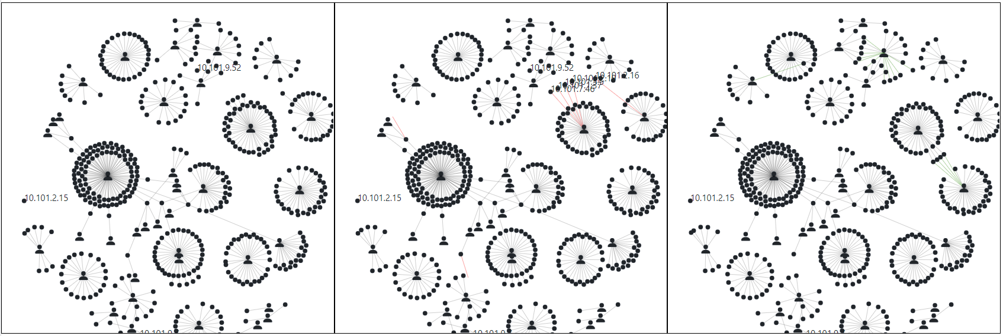
Job Net – Time slices
Dependent forces

Slide 5
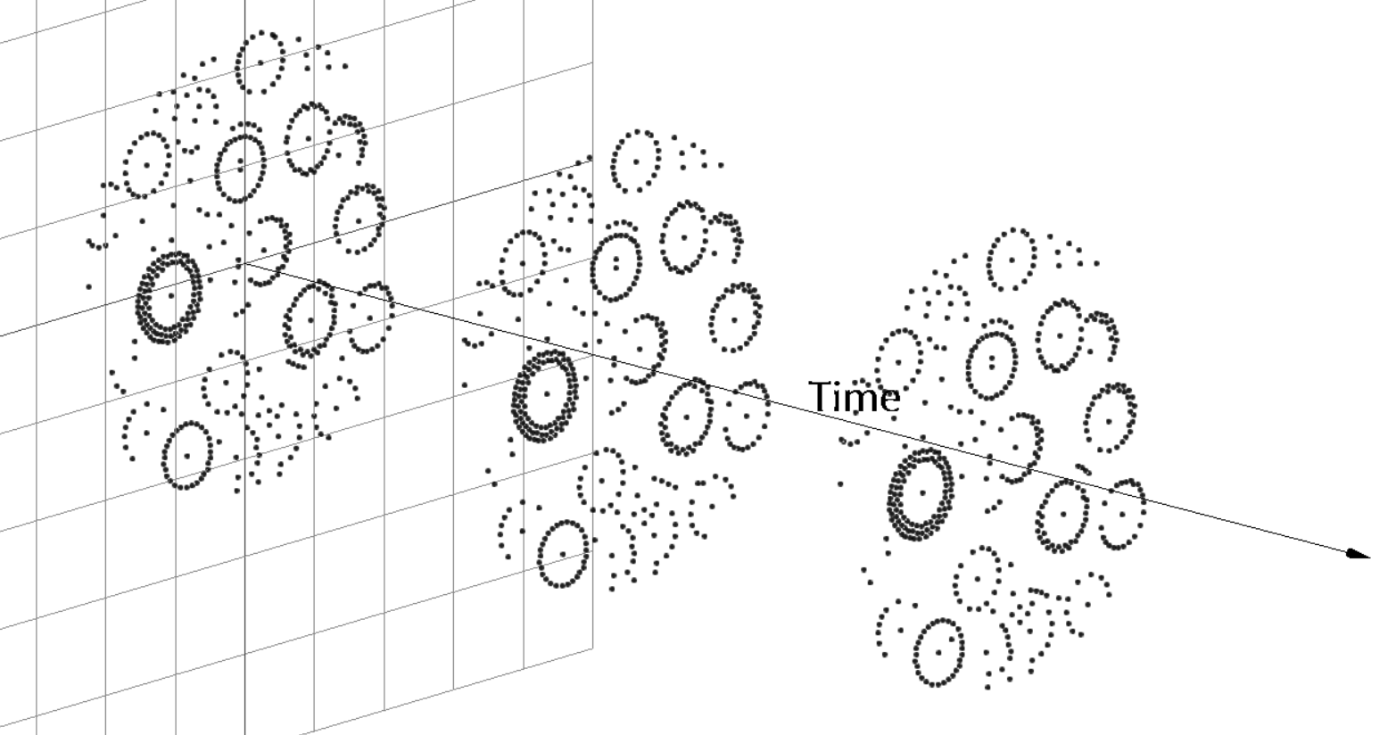
Dynet3D

Slide 6
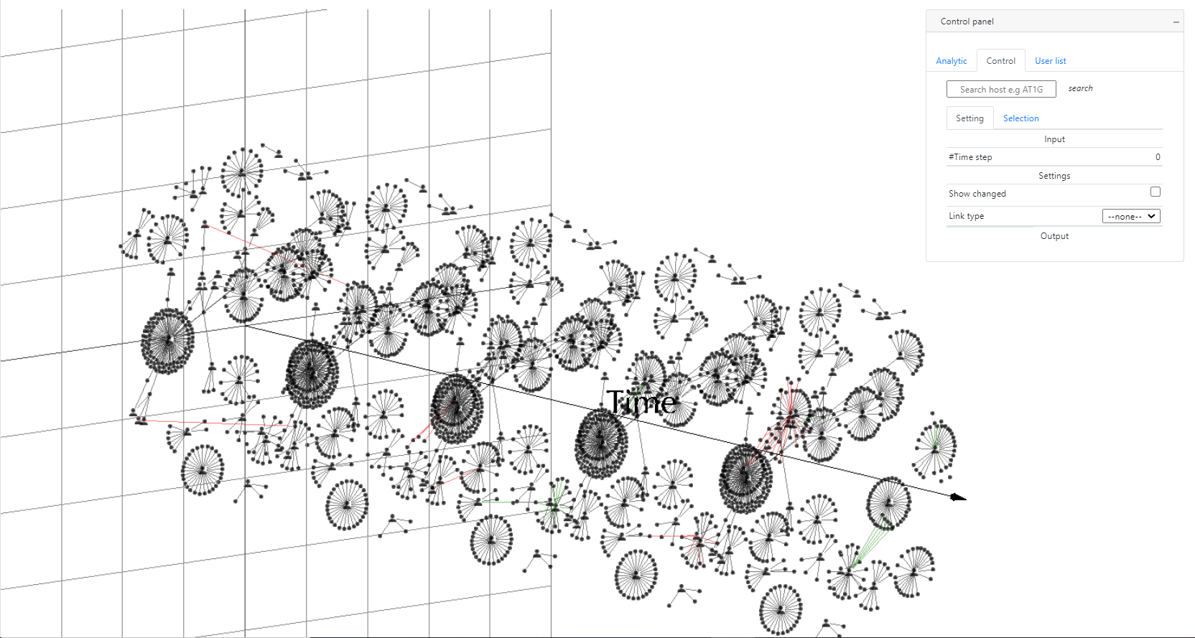
Dynet3D

Slide 7
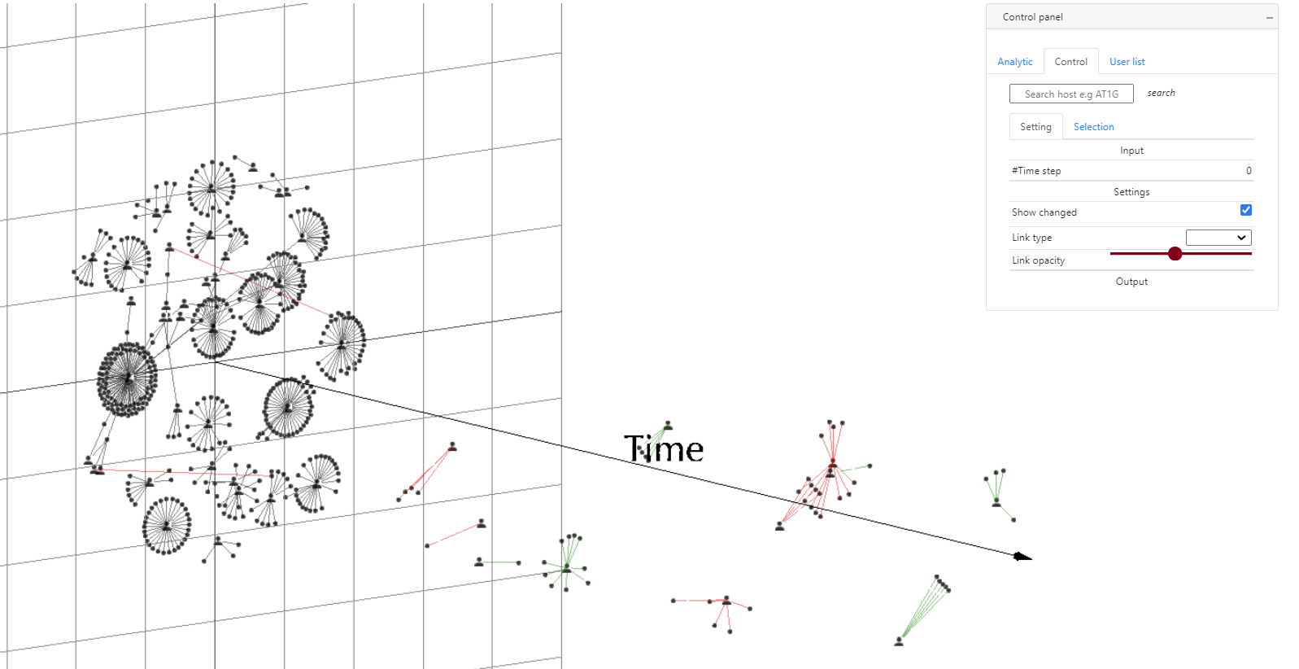
Dynet3D

